Slide 1




BDM Capstone Project [Sept 2024]
Sales Performance Analysis and Marketing Optimization for a Retail Home Decor Business
by Saransh Saini [22F1001123]

Slide 2
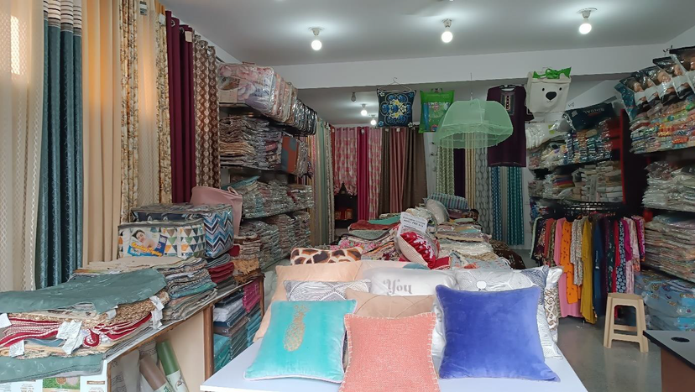
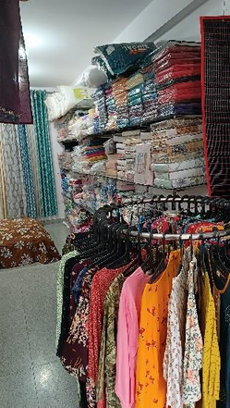
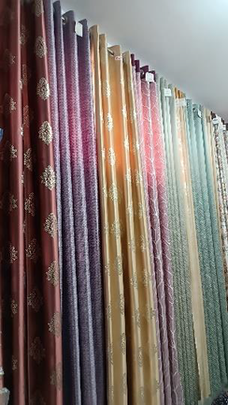
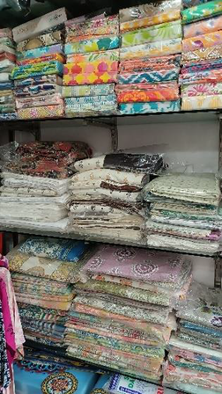
The Business and The Problems
About the Business
Name of the Business: Noble Homes Decor
Type of Business: B2C Retail shop, specialising in Handloom and Home Decor Products
Location: Neb Sarai, Delhi, India
Founder: Mr. Radha Krishnam
Background: The shop was founded in February 2024 by the founder, after shutting down their Computer Repair and Reselling business due to high competition.
Problems
Low Sales: Since it’s inception the business as faced challenges in increasing their sales, despite providing high-quality products.
Lack of Brand Presence: The business lacks a strong marketing presence both offline and online, contributing to low brand visibility in this competitive market.
Data Collection
501 Hard copies of customer bills were provided ranging from Feb 2024 to Sept 2024
Manual data entry operation was caried on these bill copies to make it eligible for analysis.

Slide 3






Data Cleaning and Preprocessing
Before going ahead with the analysis part it was necessary to clean and preprocess the data. A series of preprocessing operations were carried out on the dataset making the data eligible for the data analysis operations.
Data
Cleaning
SKU
Clustering
Category Classification
Quantity Standardisation
Latitude & Longitude Mapping
Duplicate bills, incorrect spellings, etc errors were rectified
SKUs were clustered into similar types of SKUs using OpenRefine
64 SKUs were classified into 7 major categories.
The quantities were standardised to a common level of measurement.
The Addresses in the dataset were geocoded to enable them for further analysis

Slide 4






Objective and the Methods
Objective: The aim of the project is to analyse the extracted data and draw out actionable insights that may help the business to boost up their sales and build a strong brand image in the market.
Methods of Analysis: After a rigorous data cleaning and preprocessing operation, 5 methods of analysis were deployed on the preprocessed dataset to uncover categorical sales influence, product performance, customer behaviour and future sales trends.
Categorical Sales Influence
SKU Performance Classification
Market Basket Analysis
Customer Geo-Mapping
ARIMA Sales Forecasting
To understand the influence of each category on total sales
To identify which SKUs are the drivers of business, contributing the most towards the growth of the business.
To identify products that are frequently bought together, helping us understand customer behavior.
Understand customer distribution and try to identify regions of interest.
Create a model, capable of predicting the future sales values the business can experience in the following months.

Slide 5

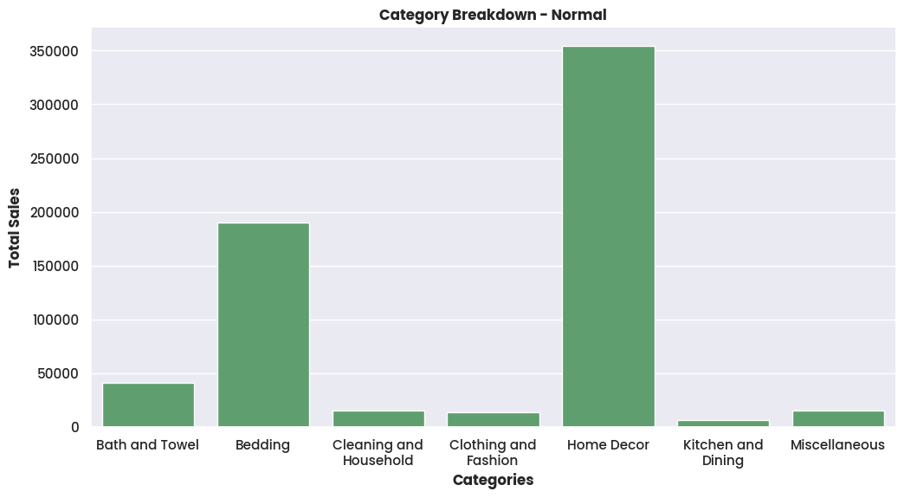
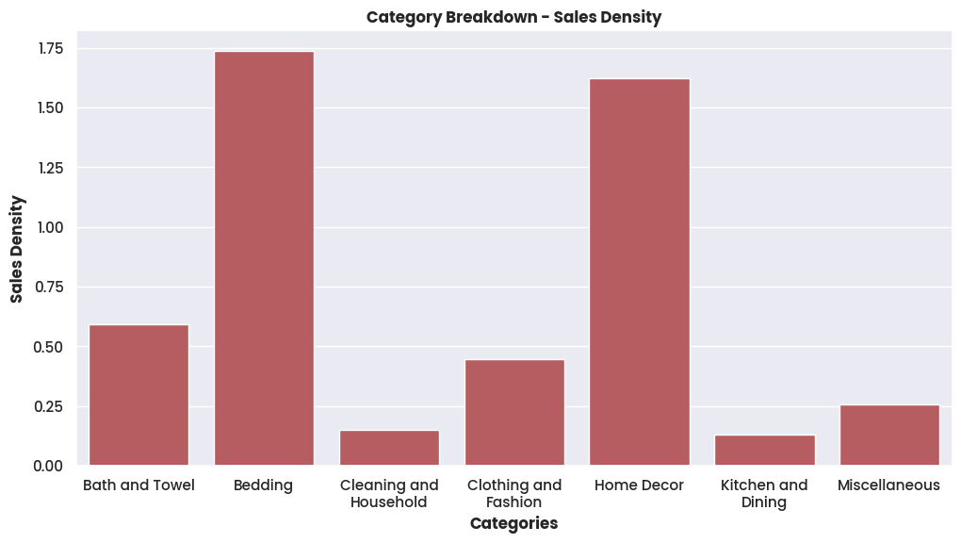
ANALYSIS 1
Categorical Influence on Sales
Explanation
Standard Aggregation: The first graph simply aggregates the total sales for each category
Normalized Aggregation: The second graph takes into account the number of SKUs in the category and aggregates using sales density.
Results and Findings
Bedding category despite fewer SKUs holds the most influence on the sales, making it the most profitable category to invest in.
Clothing and Fashion category being ranked amongst the low performers in normal breakdown, ranks as the 4th most influential category, meaning low SKU count but very high sales.
Bath and Towels is influential in both charts meaning given the number of SKUs the performance is bit above average.
Cleaning and Household, Kitchen and Dining, and Miscellaneous categories show little influential capacity in both the charts, indicating towards low SKU count and low sales.
Bedding, Home Décor, Bath and Towels, and Clothing and Fashion categories are the 4 pillars of sales in the business.

Slide 6
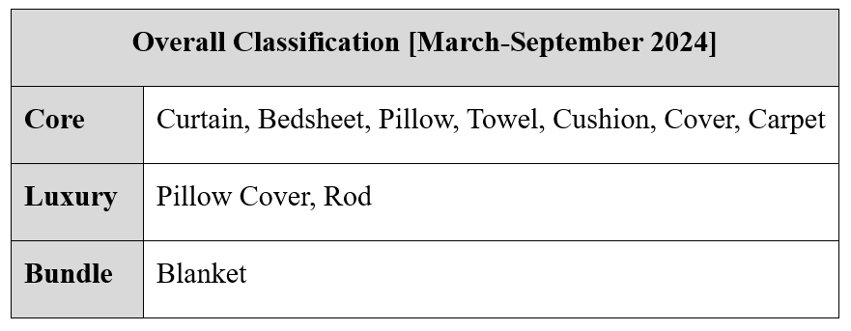
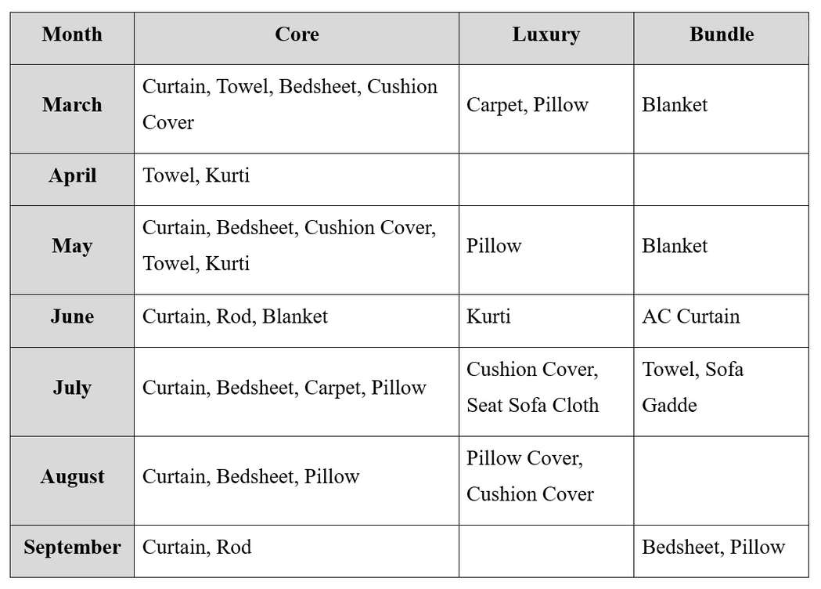
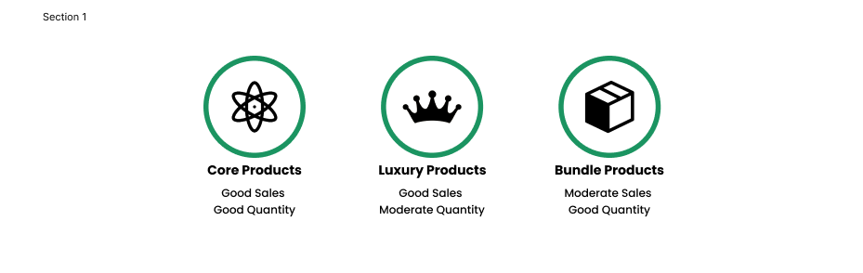
ANALYSIS 2
SKU Performance Classification
Explanation
ABC Analysis was used to classify 64 SKUs into 3 classes based on sales and quantity: Good Performers, Medium Performers, and Poor Performers.
These classes are further combined into 3 section
Results and Findings
Curtains dominate both sales and quantity purchased metrics, making it the highest values product in our inventory.
Pillow Covers have good sales but an average quantity sold, means they may be purchased alongside Pillows (a Core product.)
Bedsheet is a Core Product in the months of March, May, July & August, indicating towards no particular seasonality associated, meaning its an evergreen product.
AC Curtains are being sold in bulk in the month of July, which is the hottest month of a year.

Slide 7
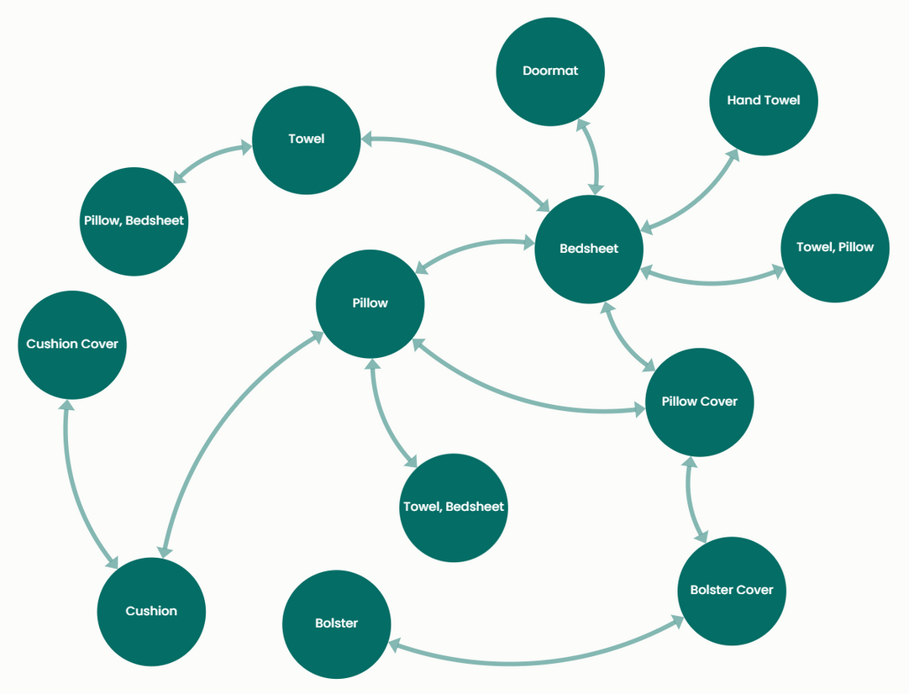
ANALYSIS 3
Market Basket Analysis
Explanation
Using Association Rule Mining we identified product pairs that are frequently bought together.
For this the Apriori Probability algorithm was used with confidence value being >0.2 and lift being >1.
Using this 14 promising rules were derived which satisfied the conditions.
Results and Findings
Bedsheet is the central product, being frequently bought alongside other core and luxury products.
Pairs like Pillow with Pillow Covers, Cushion with Cushion Covers, Bolster with Bolster Covers are obvious and are self-explanatory.
Distinct pairs like, Bedsheets with Doormats, Pillow Covers with Bolster Cover and Pillow with Cushion can be used for cross-selling.

Slide 8
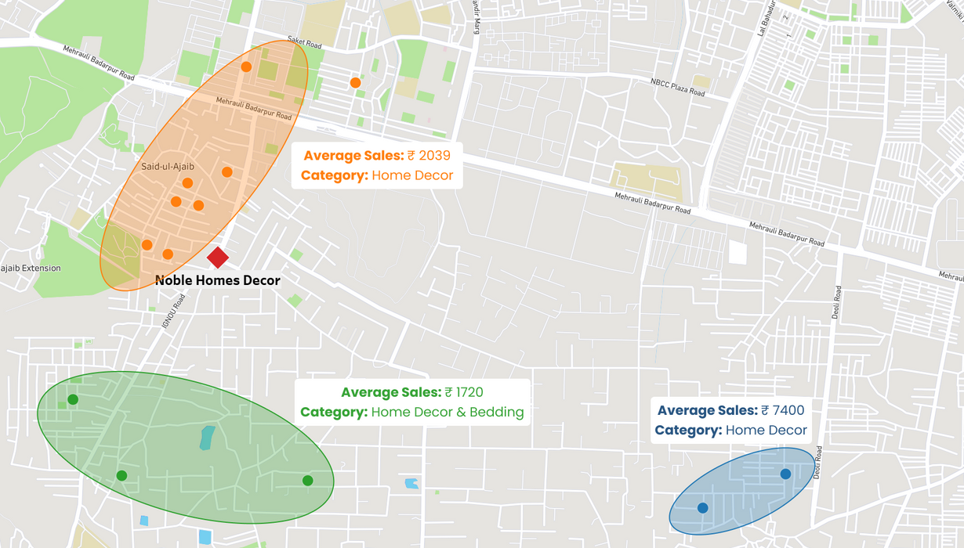
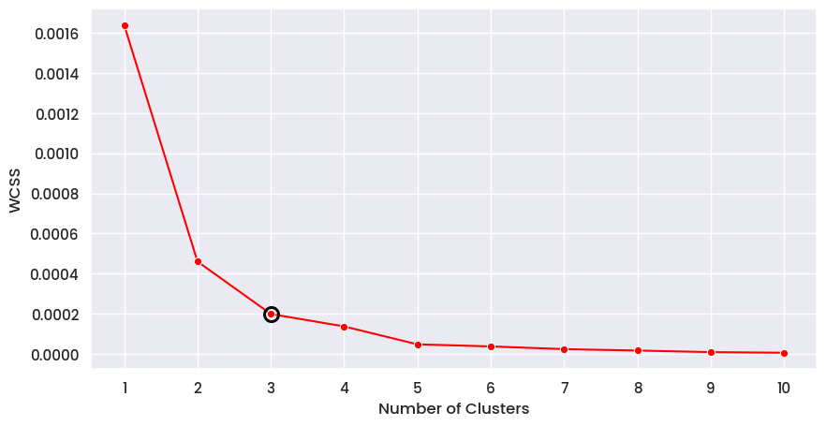
ANALYSIS 4
Customer Geo-Mapping
Explanation
The 14 addresses in the dataset were Geocoded to get there latitudes and longitudes.
These 14 geocodes were clustered using the KMeans algorithm, with the optimal number of three clusters determined through the Elbow Method.
Results and Findings
The Orange Cluster has the largest customer base, potentially due to being in close proximity with the shop.
The Blue Cluster, despite having only two data points dominates other clusters in terms of Average Sales, indicating presence of a rich neighborhood, making it a region of high interest.
The Green Cluster have reasonable average sales given the number of data points, meaning it can be considered moderate interest region.
On further investigation, the Orange Cluster seems to be an apartment complex with middle class families. This presents a multitude of marketing opportunity in the region.

Slide 9
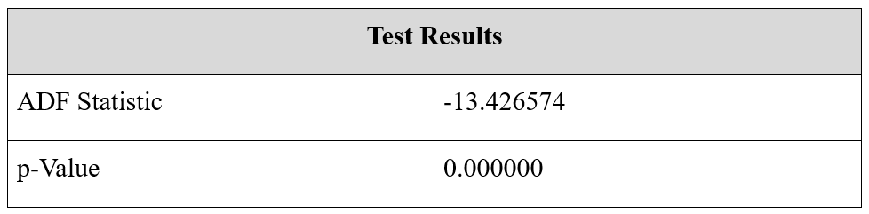
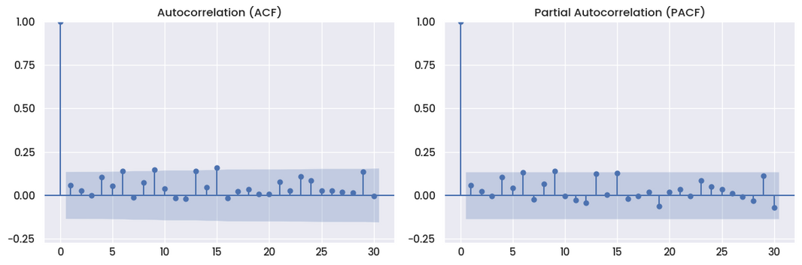
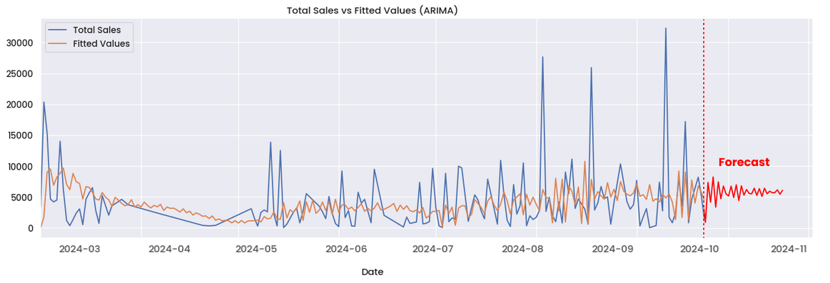
ANALYSIS 5
ARIMA Sales Forecasting
Explanation
Using the dataset spanning 7 months, a well functioning ARIMA Model was trained, after interpolating the missing values in the dataset.
ADF Statistics and p-value were used to determine the data’s compatibility for an ARIMA Model.
A negative ADF Statistic and p-value <0.05 are necessary for a good fit.
Using the ACF and PACF graphs the parameters for the model were determined. p=6, d=1, and q=6
Results and Findings
The forecast values indicate towards a moderate improvement in total sales in the coming months on (October and November).
The model indicates slight fluctuations in the forecasted sales, suggesting some external factors maybe at play.

Slide 10
Recommendations
1
Invest more resources and promotional activities on these Bedding, Home Décor, Bath and Towel, and Clothing and Fashion categories.
It would be beneficial to invest more on our strong points rather than an equal distribution.
2
The business should focus on creating a strong brand image as the “Best Shop for the Best Curtains”. The inventory should have an incredibly wide range of options, ranging from mid-range to premium quality products, having multiple design and size types.
3
The shop’s interior should also be adjusted in such a way that it communicates the above mentioned brand value. Moreover in the upcoming festive season, they can start selling customized curtains on special customer requests, helping them in monopolizing over the curtain market.
4
Clothing and Fashion category performed remarkably despite having fewer SKUs, indicating a strong customer interest in clothing items. The Business should consider introducing more SKUs of multiple sizes and designs in this category to cater to the demands.
5
Product pairs like Pillow and Pillow Cover, Bolster and Bolster Covers, and Cushion and Cushion Covers can be bundled together and marketed as combo offers, even small amounts of discounts can be put on these combos to boost up the sales even more.
6
Free home delivery services can be provided in the Orange Cluster region. Being right next door won’t cost us much for delivery. Instead, these services would create a positive brand image, helping in the promotion by word-of-mouth.
7
The presence of rich households in the Blue Cluster, makes it crucial to build a strong brand image in the region. This can be achieved by aggressive marketing, low-cost delivery services, and introducing loyalty programs, that reward customers with discounts or free items after accumulating enough loyalty points.
8
To tackle slight sales fluctuations, flexible stock management system that adjusts inventory levels based on forecasted demand and trends need to be implemented. In periods of low sales, introducing flash sales or limited-time offers can help smooth out the fluctuations.

